Slide 1
Disease Prediction Using Medical Comprehend
Made By: egabi Solutions AI Team

Slide 2
Problem Statement
“Don’t google your symptoms”.
It’s a world-wide problem that people google their symptoms searching for quick cheap diagnosis which may lead to underestimating / overestimating their medical conditions.
These kinds of results could make them avoid the doctor because they don’t want to hear bad news or they’ll worry so much that it leads to other harmful consequences.

Slide 3
Solution
Building an AI Model that can help the patients to have some sort of understanding of what their medical symptoms could mean, and provide them with an initial diagnosis for their symptoms, that would be more reliable than googling them.
It is not a substitute for professional medical advice, diagnosis, or treatment.
The patient will write a text explaining his/her symptoms and the model will diagnose the patient’s medical condition.

Slide 4
Step By Step
Classification model was trained using a Disease Prediction dataset.
Amazon Medical Comprehend is used to extract patient’s medical information from medical text.
A semantic similarity method is used to measure the similarity between the medical information and some predefined features which represent medical symptoms.
Only the medical symptoms with similarity above a specific threshold are taken into consideration.
The classification model takes the chosen features as input and predicts the best diagnosis.

Slide 5
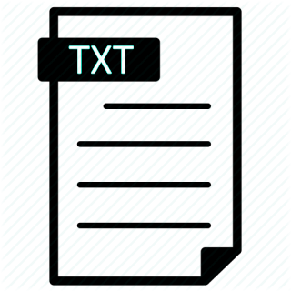

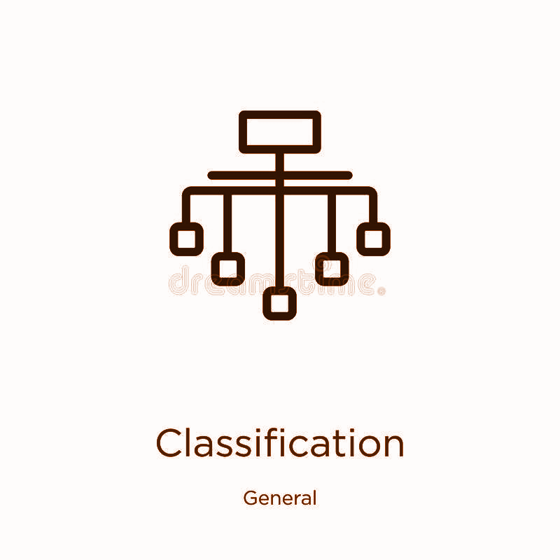


Pipeline
Textual Input
Amazon Comprehend Medical
Semantic Similarity Method
Classification Model
(SVC)
Diagnosis

